Slide 1
Python 1-Hop Main Pod Code
BETA VERSION
Caroline
12/19/23

Slide 2
What this code accomplishes so far:
Data preprocessing
Crop data to deployment log start and end times
Combine pod data files that may have different columns
TempC2K, HumRel2Abs, Rmv999, RmvNaN, TimeSort, RmvWarmup
Time averaging (mean or median, but must be the same between ref and pod)
Fig 2600/2602 ratio
Interaction terms
Multiplies each sensor combo, so with CO, temp, humid sensors, you’ll add CO*temp, CO*humid, and temp*humid
Harmonization of sensors to colocation pod sensors
Different than matlab, which calibrates pods to a concentration timeseries from the colocation pod
Only uses linear regression
Uses K-fold cross validation

Slide 3
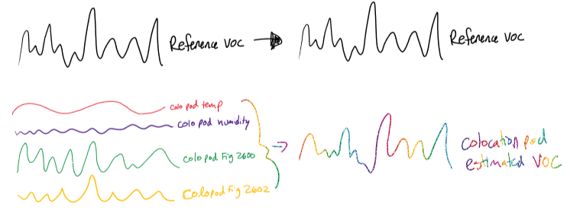
Illustrating the difference in harmonization
Colocation step, the same in both Matlab and Python

Slide 4
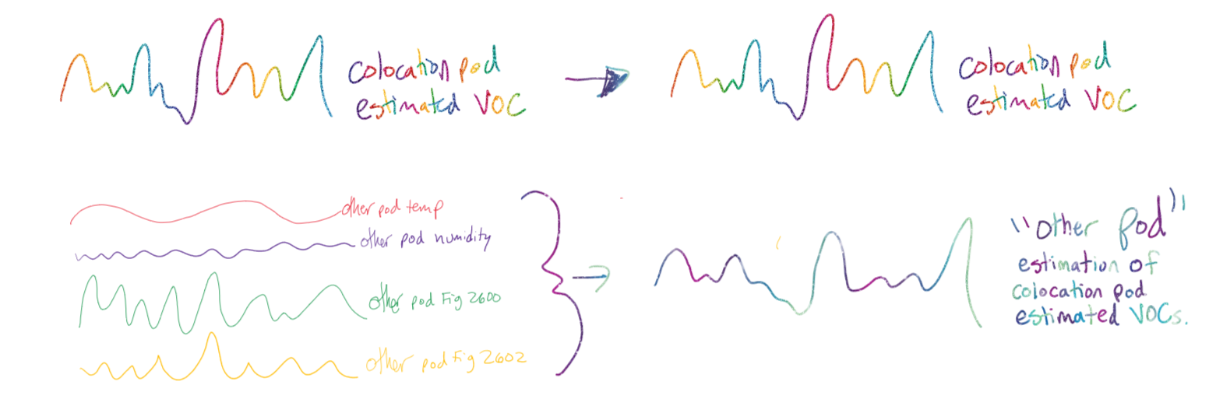
Colocation 2 (the “Hop”) in Matlab

Slide 5
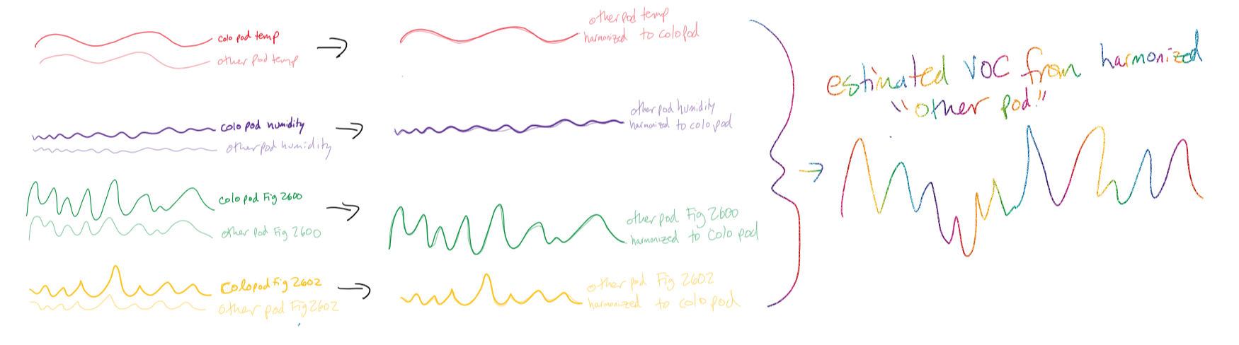
Harmonization in Python

Slide 6
What this code accomplishes so far:
Calibration of colocation pod to reference
Grid search (k-fold cross validation) to optimize hyperparameters of machine learning models
Train/test split before hyperparameter tuning to reduce data “leaking”
Scaling of data after train/test split to reduce data “leaking”
Model options right now are:
Linear regression (no CV for hyperparameters)
Ridge and Lasso regression (linear regressions that reduce overfitting)
Random Forest
Relatively easy to add more!
train
test

Slide 7
What this code accomplishes so far:
Field data harmonization & calibration
Applies the harmonization linear regression to each sensor in a pod
Then applies the colocation calibration model to the harmonized pod data
Some plotting
RMSE, R2, MBE stats across different colocation calibration models
Time series of colocation pod corrected timeseries vs. reference
Colocation pod vs. reference scatter plot
Colocation pod residuals vs. sensor inputs
harmonization stats, scatter, and timeseries
Box plot of pod field data concentrations
Time series of corrected field data

Slide 8
What I’m still working on:
Other machine learning models
Binning of colocation data like Jon’s methane paper
Feature importance exploration (to decide which variables to include)
Other than the datetime column(s), all pod data columns MUST be numeric
Is this ever going to be an issue?
Beta testing & improvements

Slide 9
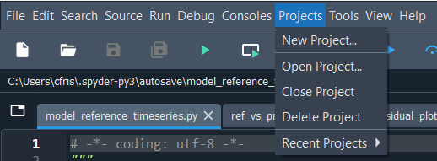
Setting up python
I used Spyder (through anaconda) but am now trying PyCharm because it is easier for Github (although causing issues elsewhere)
For Spyder,
download anaconda
in anaconda, download spyder
Open the anaconda terminal and type “spyder”
Once spyder is open, navigate to Projects ➔ New Project… and create a folder in a new directory where you will store all of the data folders and scripts. This will automatically create the .spyprojects folder inside of the folder you name
I set up spyder a long time ago so I don’t remember what other settings need to be changed… we will have to work together on this

Slide 10

Pycharm set up
For pycharm,
Download anaconda
Download pycharm
Will need to get student license but can start out with free trial
In pycharm, go to file → new project

Slide 11
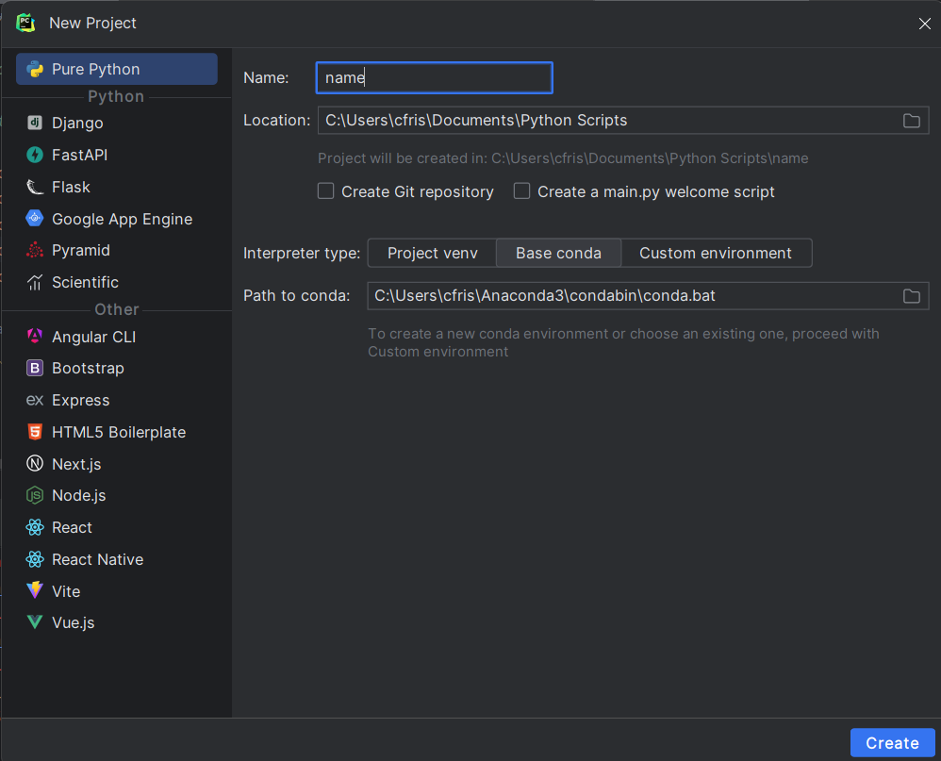
Pycharm set up
In the new project window, choose a name for the folder that will contain all your data and scripts
Path to conda should be set to wherever Anaconda is located

Slide 12
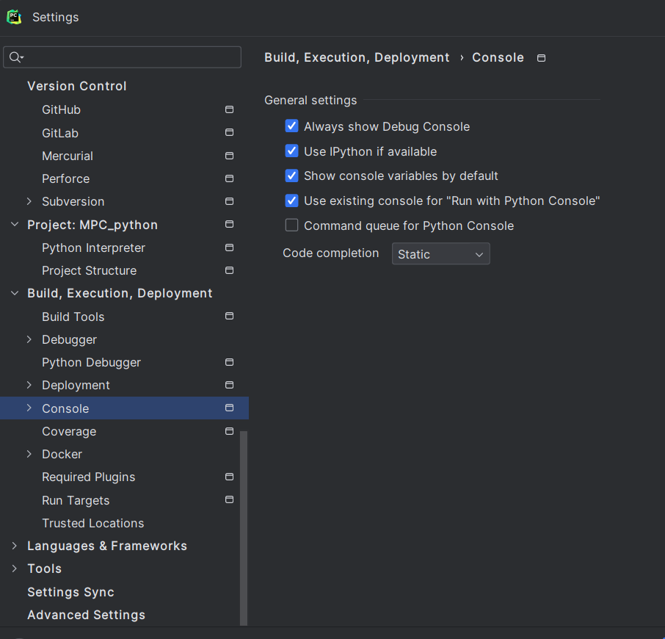
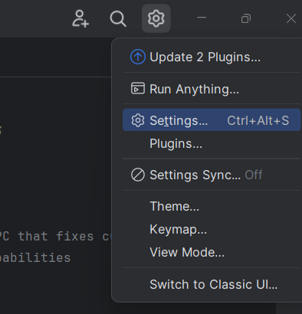
Pycharm set up
Navigate to settings → console and make sure you have the settings checked like in the screenshot

Slide 13
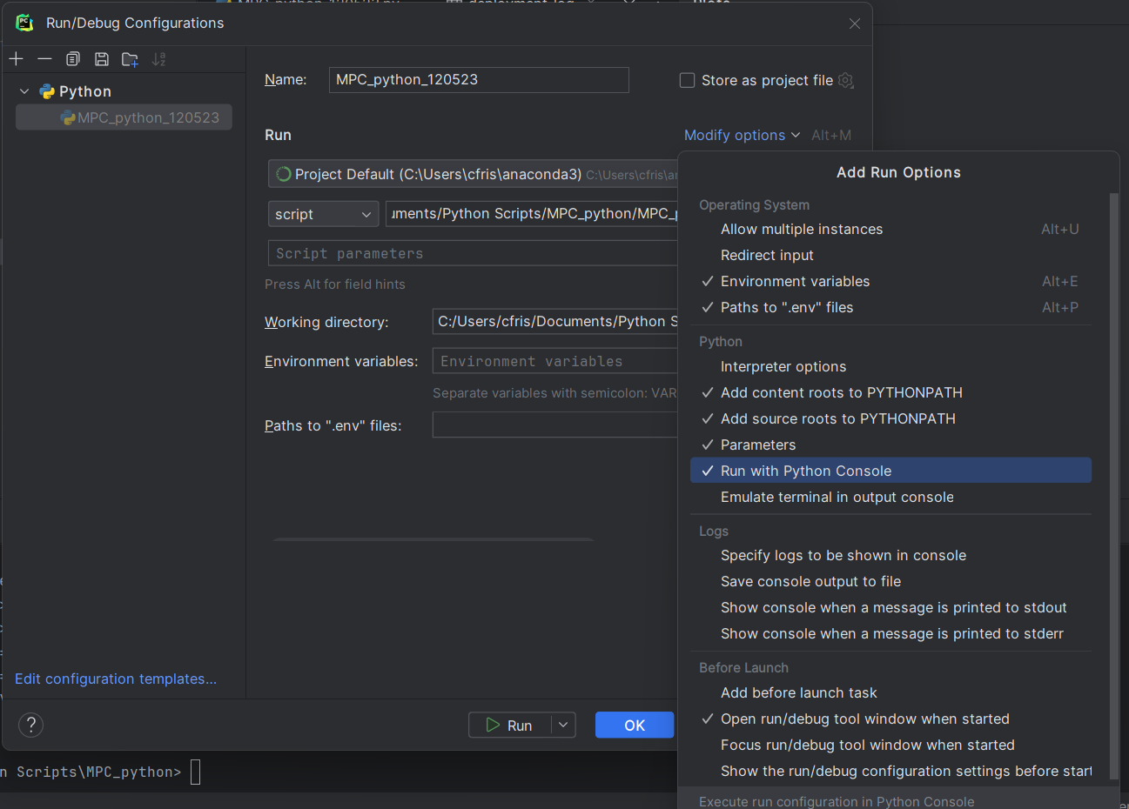
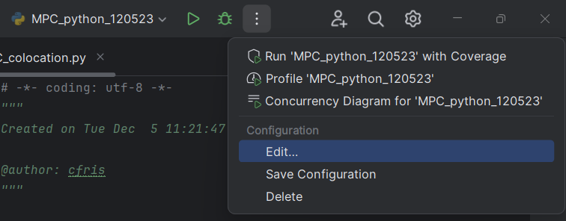
Pycharm set up
Navigate to edit configuration (see screenshot)
Then open the modify options menu and make sure it matches the screenshot

Slide 14
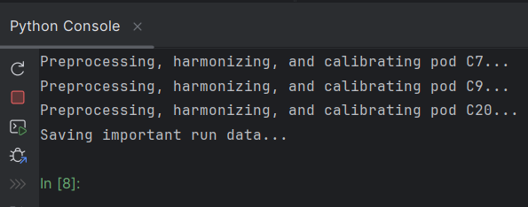

Pycharm note
If you make changes to .py file in Python_Functions (preprocessing_func, plotting_func, etc.), you will need to close out of the console at the bottom of the pycharm window before you rerun the MPC codes (_colocation or _harmonization_field)
Otherwise, the changes to the Python_Functions file will not be imported
Then, open a new python console using this bottom in the bottom left

Slide 15
Cloning the python scripts through github
Download git https://www.git-scm.com/download/win
In powershell/command prompt, navigate (using cd) to folder you created in pycharm/spyder that has the projects files
Example navigation: PS C:\Users\cfris\Documents> cd Newfolder
Clone git by typing “git clone” and then the url for the files
Example: PS C:\Users\cfris\Documents\Newfolder> git clone https://github.com/cafr1977/MPC_python.git

Slide 16
GITHUB LINK
https://github.com/cafr1977/MPC_python.git

Slide 17
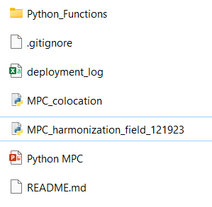
Cloning python scripts through github
Now, you should see these files automatically in the folder
You will need to add Colocation, Field, Harmonization, and Outputs folders (see following slides)
You will also need to update your deployment_log!!!

Slide 18
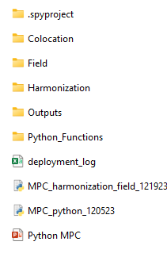
Folder set up:
Colocation and Field folders are the exact same as matlab MPC
Outputs folder can be empty to start. It is where output folders will be saved to
If using Spyder, there will be a folder called .spyproject (automatically generated when you create a project)
If using pycharm, there will be a .idea folder (automatically generated when you create a project)

Slide 19


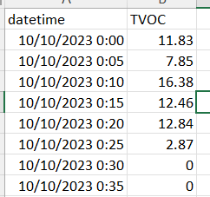
Colocation Folder
Inside Colocation, there should be two folder: Pods and Reference
“Pods” will contain .txt files of raw pod data
There should be one pod file for each “colocation” file listed in the deployment log!
One file might be listed multiple times if it is for multiple pollutants though..
“Reference” will contain files of reference data
Can be either .csv or .xlsx
First column is “datetime”
After that, you can have as many columns you want of reference data.

Slide 20
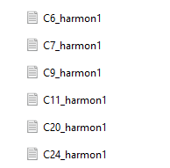
Harmonization Folder
Within Harmonization, there should be.txt files of the harmonization data
One pod file per deployment log entry!
This should include both field and colocation pods’ harmonization data!
In other words, the data for the secondary standard pod should also be in this folder

Slide 21
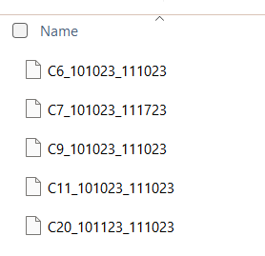
Field folder
Within Field, there should be.txt files of the field data
One pod file per deployment log entry!

Slide 22
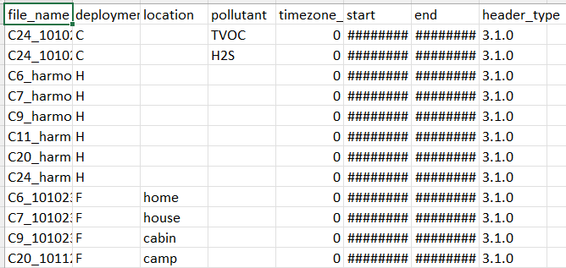
Deployment log named “deployment_log.xlsx”
or “deployment_log.csv”
file_name: The full name of the data file (do not write .txt)
Deployment: C for colocation, H for harmonization, F for field
Location: Only important for field. Python will plot field data based on location.
Pollutant: If it is C (colocation), add the pollutant of interest. This is because some of us have multiple colocation sites and we need to differentiate
If it is not C, you can leave it blank
timezone_change_from_ref: How many hours is it different than the reference?
-1 if it is one hour behind (pod writes 3pm when ref data is 4pm)
1 if it is one hour ahead (pod writes 5pm when ref data is 4pm)

Slide 23
Deployment log named “deployment_log.xlsx” or “deployment_log.csv”
Columns:
start: when did the deployment start?
You do not need to account for warm-up here, as that will be removed in preprocessing
end: when did the deployment end?
header_type: specify what the headers/columns are for the specific file
Now, you can have diff columns for the same pod, as long as you have separate data files for each firmware version

Slide 24
A note on data file naming conventions
Pod names are identified by whatever comes before the underscore “_” in the file name
So if a file name is C24_0123_2212, the pod name would be C24
For PodID25_cadkfjladkjfl, the pod name would be PodID25
You can have anything you want after the underscore
Python will make a list of each of the individual pod names (C24, PodID25) and combine data files together based on what pod they come from
So you can have multiple files, all listed in the deployment log, that will get combined as long as they have the same pod name

Slide 25
A note about pod data files and firmware data writing
You can have one datetime column, or a date column and a time column that python will automatically combine
Must be called datetime or date and time (if two columns) in the column_names variable
Right now, the rest of the columns must be numeric. If at some point, we have non-numeric data columns (not sure what this would be), we’ll need to adjust the data_load function
I haven’t spent time on this yet because I do not foresee any non-numeric data needs

Slide 26
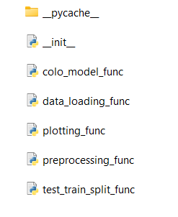
Python_Functions folder
This folder contains other functions used in the main functions
You must have the _pycache_ folder and __init__ for this to run
You can add more functions with each grouping, or create a new file if you want a new category of functions

Slide 27
Python_Functions functions
data_loading_func file
load_deployment_log loads the deployment log
load_data is used to load C, H, and F data, based on the deployment log entries. Load_data also corrects any time zone changes and crops the data based on start and end times in the deployment log (remove warmup happens later in preprocessing)
field_location groups the field data by location (instead of pod) for plotting and analysis
test_train_split holds functions to split the data into test and train sets
end_test puts the last 20% of temporal data into test
mid_end_split puts 10% of middle data and 10% of the end data into test

Slide 28
Python_Functions functions
preprocessing_func contains data preprocessing functions
add_time_elapsed creates a column that is the number of seconds that have passed since the earliest time listed in “start” in the deployment log. This is helpful for accounting for sensor drift!
fig_ratio adds a column that is the ratio of Fig 2600 to Fig 2602 (helpful for VOC)
hum_rel_2_abs converts humidity from relative to absolute
interaction_terms multiplies each sensor combo
so with CO, temp, humid sensors, you’ll add CO*temp, CO*humid, and temp*humid columns

Slide 29
Python_Functions functions
preprocessing_func contains data preprocessing functions
rmv_warmup removes the first warm-up period in the data, as well as a warm-up period after each time the pod turns off
User specifies the warm-up period in the settings
Python assumes the pod turned off each time the gap between two samples is more than 10 times longer than the average time gap between samples
temp_C_2_K converts the temperature from Celsius to Kelvin
preprocessing_func contains the function calls of some of the preprocessing steps. This just keeps the main code a little cleaner.
Not all of the preprocessing steps can be included here because some have to happen after the data has been time averaged. Those are called specifically in the main code in that case

Slide 30
Python_Functions functions
colo_model_func contains the models that can be used for the colocation pod to reference calibration
lin_reg is a multi linear regression
ridge and lasso are regressions with “regularization” to minimize overfitting
random_forest
Models with hyperparameters are tuned using 5-fold cross validation
What that means: hyperparameters are parameters you pre-set for the model, such as the max depth in a random forest. “Tuning” is when these hyperparameters are optimized to build the best possible model for the data

Slide 31
Python_Functions functions
Plotting_func contains plotting options
Plots are separated by harmonization, field, and colocation data
Stats plot shows the R2, RMSE, and MBE
For some reason, harmon_stats_plot doesn’t always show up in pycharm. However, it will be saved as a png in the outputs folder for you to view.

Slide 32
Outputs folder
This folder starts out empty
When you run MPC_colocation, python will create a new folder named Outputs_[current datetime]. Results from the run will be saved in this new folder
When you run MPC_harmonization_field, python will create a new folder within the MPC_colocation output folder (Outputs_[datetime]) that is again named as Outputs_[current datetime].
You can rename these folders however you’d like

Slide 33
Outputs folder files
In the first output folder (for the colocation step)
Colocation figures
Colo_model_stats: R2, RMSE, and MBE
Colo_X : preprocessed pod data used in colo model
Colo_X_std: standardized preprocessed pod data used in colo model
Colo_y_reference: reference data (retimed to match X)
{model_name}_colo_y_predicted: predicted y from calibrated pod data X
Run_settings.joblib: python variable that saves the run settings
{model_name}_model.joblib: python variable that saves the model (coefficients, etc.)
Joblib variables can be loaded into python using joblib.load()
After you have imported the joblib package

Slide 34
MPC_colocation
This function calibrates the colocation pod data to the reference data
Packages you need to install before running:
os
matplotlib
pandas
sklearn
datetime
importlib
joblib
atmos
numpy
xlsxwriter
tensorflow
seaborn
copy

Slide 35
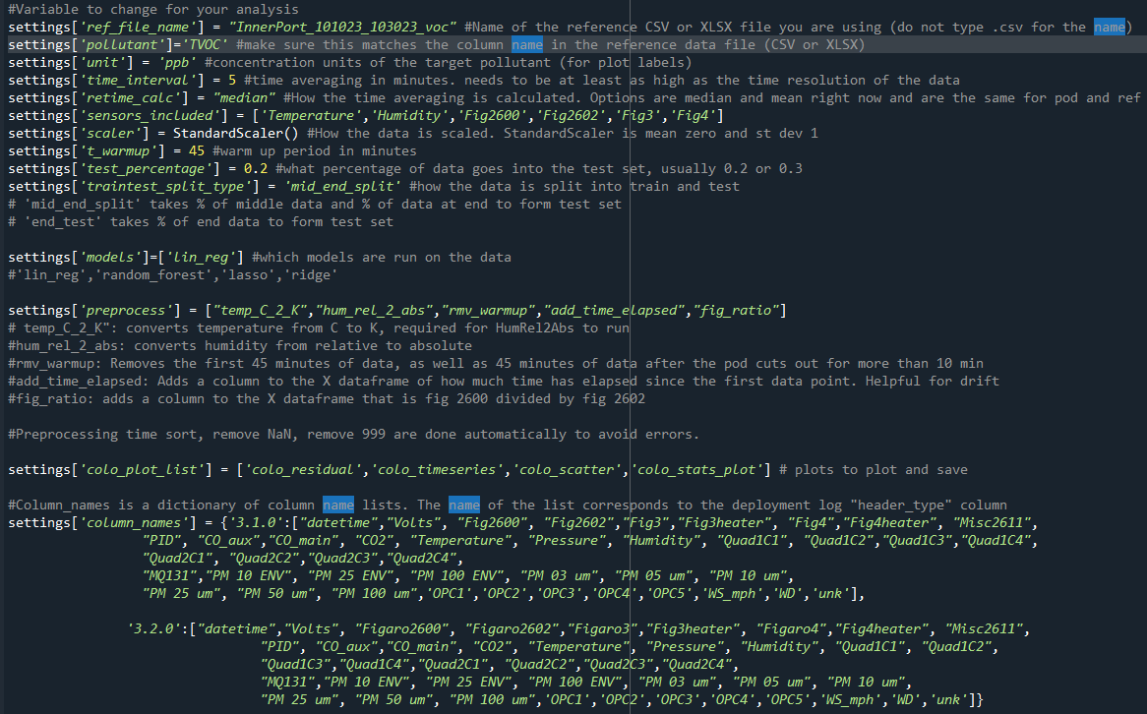
MPC_colocation
You must pre-set the settings at the start of the code. There are notes next to each setting variable to inform you
If you aren’t sure of the options for ‘traintest_split_type’, ‘preprocess’, ‘models’, or ‘colo_plot_list’, you can look in the Python_Functions folder for function options and names.

Slide 36
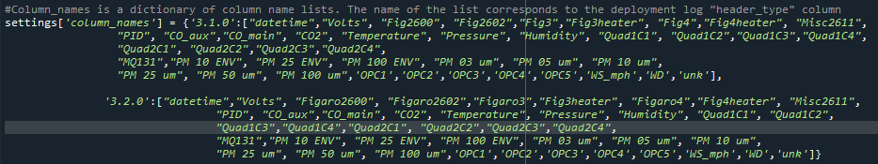
Settings[‘column_names’]
In the deployment log, each row represents a .txt file. The column_names variable in the last column of the deployment log specifies which list of column names should be used for that .txt file
The list will depend on what firmware was used, since the way data is written onto the SD card varies depending on firmware
The settings[‘column_names’] list can contain all the different options for column names.
You can add more to this list, just give it a name
In the screenshot, the two options are 3.1.0 and 3.2.0

Slide 37
MPC_harmonization_field
Harmonizes pod data to the colocation pod
Choose your favorite model from MPC_python_120523, and this code will apply it to field data to get calibrated field data

Slide 38
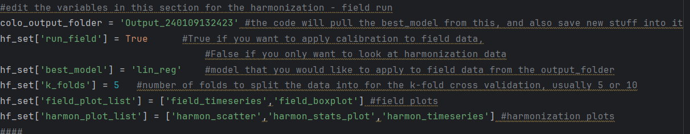
MPC_harmonization_field
Variables to adjust in MPC_harmonization_field:
colo_output_folder: list the folder name that you want to pull the MPC_colocation results from
hf_set[‘run_field’]: true if you want to apply calibration to field data. False if not.
hf_set[‘best_model’]: choose the model that you want to apply to your field data, based on the results in the colo_output_folder MPC_colocation run
hf_set[‘k_folds’]: number of folds to split data into. Read about k-fold cross validation if you are unfamiliar with this. Usually, it is 5-10
plot_list is a list of plots (separated by harmonization and field data) that you want python to plot

